Slide 1

AI coding assistants for programmers
Edgar Galindo
Hector Triana

Slide 2
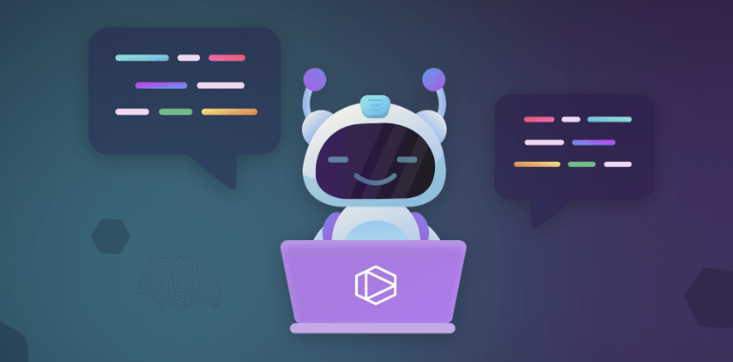
Foundations of AI Assistants for Coding
AI coding assistants are tools that help developers generate, autocomplete, debug, or optimize code. These assistants are powered by large language models (LLMs) or other machine learning approaches.
Coding AI assistants use generative models like GPT to understand the context of the input code and predict the next steps. They have been trained on large datasets, such as open-source repositories and documentation, to learn coding patterns and best practices.

Slide 3
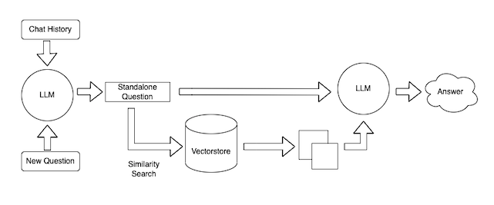
How AI Assistants for Coding work
AI code assistants use advanced Natural Language Processing (NLP) techniques that allow the assistant to process large amounts of code data, understand coding patterns and structures, and generate suggestions or insights that can be useful for developers in their current context; and, more recently, Large Language Models (LLMs) like GPT-4. These models process code patterns and structures to generate context-relevant suggestions, translating natural language prompts into usable code.
Training Process:
Pre-training on vast datasets to learn code structures.
Fine-tuning on specialized data for improved accuracy.
Some assistants are trained on public code repositories, while others use organization-specific data for more tailored support.

Slide 4

Key Features of AI Code Assistants
Autocompletion: Predicts code based on context, offering entire blocks or functions from partial input.
Refactoring Suggestions: Analyzes and suggests optimizations, often with explanations.
Error Detection: Identifies potential errors and provides fixes, saving debugging time.
Documentation Generation: Creates comments and documentation, explaining code in natural language.

Slide 5

Types of AI Code Assistants
Code Generation Tools: These tools can generate entire functions, scripts, or even complex code blocks based on a description. Examples include GitHub Copilot and OpenAI Codex.
Code Autocompleters: These tools assist developers with real-time suggestions and autocompletions, enhancing productivity. Examples include TabNine and IntelliSense.
Debugging Assistants: Some tools help debug code by suggesting fixes for errors or potential improvements. They work by analyzing the code structure and finding potential flaws.
Code Refactoring Tools: These assistants improve the structure of code without changing its functionality, making it more readable and maintainable.

Slide 6
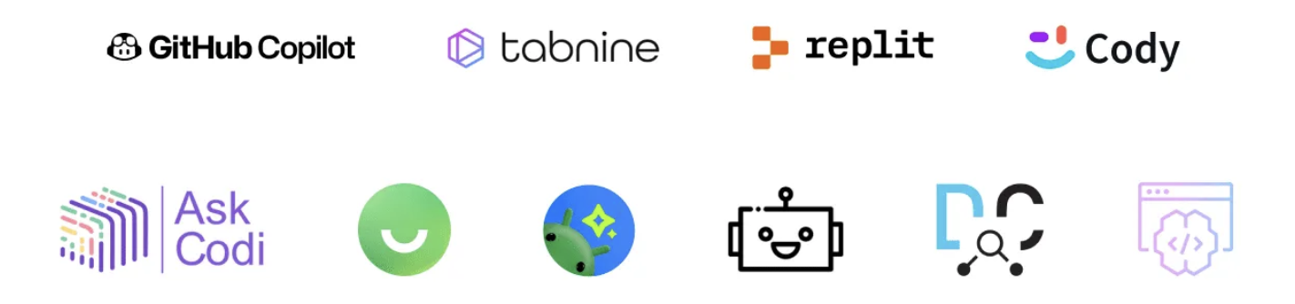
Examples of Coding Assistants
GitHub Copilot: Powered by OpenAI Codex, it helps generate code based on natural language descriptions and provides real-time suggestions while coding.
TabNine: Uses machine learning to provide code autocompletion, and it supports multiple languages and IDEs.
AWS CodeWhisperer: A tool similar to Copilot that helps developers write code using natural language prompts, particularly suited for cloud-native projects.
Replit Ghostwriter: Focuses on providing developers with code samples instead of code completions. Developers can describe the functionality they need, and Ghostwriter will generate a code snippet to achieve that functionality.
Codium: deeply analyzes your code and offers improvements including the addition of docstrings, exception handling, and the implementation of other best practices.
AskCodi: takes a conversational approach to coding assistance. It understands and responds to developer questions in natural language, provide explanations, recommendations, and coding solutions in a dialogue format.

Slide 7
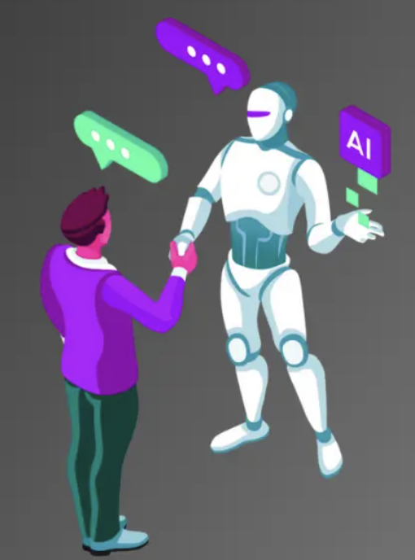
Technical Criteria for Selecting an AI Assistant
Use Case Fit: Choose the assistant based on your use case—whether you need it for code generation, autocompletion, or debugging.
Programming Language Support: Different AI assistants have strengths in different languages, so choose one that supports your main stack (e.g., Python, Java, JavaScript).
Quality of Suggestions: Evaluate the model’s performance in producing correct and functional code. For example, GitHub Copilot is more suited for creative tasks, while TabNine offers quick autocompletions.
Context Awareness: Some assistants are better at maintaining context across multiple files or a larger project scope.
Integration and Usability: Consider how easily the assistant integrates into your existing IDE or development environment.

Slide 8
Hands-On Exercises Using AI Assistants
Easy Exercise: Basic Function Generation
Task: Write a function to calculate the factorial of a number.
Expected Outcome: AI tools should generate a correct solution, but there may be differences in readability and efficiency.
Medium Exercise: JSON Data Parsing
Task: Parse a JSON object and extract specific values.
Expected Outcome: Some assistants might handle nested structures better, or offer more sophisticated methods to parse data.
Hard Exercise: Simple Web Server
Task: Write a NodeJS web server using express or any framework with JS or TS that handles GET and POST requests.
Expected Outcome: More advanced assistants like GitHub Copilot are likely to provide more robust and complete solutions, whereas others may require more developer input.

Slide 9
Reference Links
https://developero.io/blog/ai-for-developers
https://www.vailos.com/5-herramientas-inteligencia-artificial-programadores/
https://www.geeksforgeeks.org/best-ai-coding-assistants/
https://www.thedroidsonroids.com/blog/best-ai-coding-assistant-tools
https://github.blog/ai-and-ml/generative-ai/how-ai-code-generation-works/
https://swimm.io/learn/ai-tools-for-developers/ai-code-assistants-key-capabilities-and-5-tools-to-know-about

Slide 10


